Slide 1
Supporting the Education of Looked After Children
Initial training for Foster Carers
10th February 2021.

Slide 2
Learning outcomes
Foster carers will:
Understand why education is important
Have a knowledge of educational terminology
Understand that the role of the foster carer is crucial
Be able to participate in interactions with the education service (parents’ evenings, exclusions, PEPs etc.)

Slide 3
Supporting Learning
https://schoolsweek.co.uk/sir-kevan-collins-qa-covid-innovations-can-drive-catch-up-challenge/
https://www.bbc.co.uk/news/education-55984097
https://educationendowmentfoundation.org.uk/tools/guidance-reports/working-with-parents-to-support-childrens-learning/
https://educationendowmentfoundation.org.uk/evidence-summaries/teaching-learning-toolkit/#closeSignup

Slide 4
Raising Aspirations
file:///C:/Users/cvjho213/Downloads/england-education-aspirations-summary.pdf
https://www.ambition.org.uk/blog/5-tips-aspiration-projects/

Slide 5
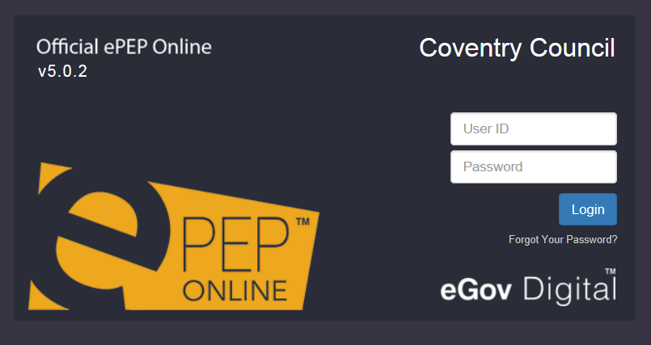
Logging on

Slide 6

https://epeponline.co.uk/auth/login?redirect=coventry

Slide 7
Case study – Y8 Boy - Mattie
Mattie has lived with you for four years and you also care for his younger brother. They are both well settled, and there have been no problems with Mattie’s behaviour at home that you couldn't deal with, at least until recently, when he has started to arrive home late in the evening. However, behaviour problems at school have been on-going for some time, having started in primary school with some fighting and disruptive behaviour in the classroom.
Mattie started off well in Secondary school, but this did not last long, and he has had many different kinds of support over the years, from time spent in the Learning Support Unit, Teaching Assistant support in the classroom, weekly sessions with a learning mentor and various report cards and reward schemes. The school has been very supportive and has involved you at every stage. Mattie had a few exclusions for fighting and bullying in Year 7, but never seems to show any remorse for what he has done.
Since the start of Year 8, Mattie has changed his friendship group and now spends a lot of time with older young people who are not good role models. He regularly misses lessons and sometimes leaves the site altogether and has had a number of exclusions, one for 5 days for bullying. There have been three meetings in school to try to address this, and at the most recent of these, it became clear that school staff are beginning to lose patience with this behaviour, especially as there are suspicions that he has been smoking cannabis during the school day. When Mattie talks about his behaviour, he seems to have a good understanding of what is going wrong, and always says the right things about how he is going to change. However, this never actually makes any difference, and school staff say he behaviour seems to be completely impulsive at times.
You are about to attend Mattie’s PEP. What questions will you have?

Slide 8
Overview
https://my.optimus-education.com/sites/optimus-education.com/files/keynote_4_-_dr_jo_lyons.pdf
Education Action Zones.
https://www.gov.uk/government/publications/social-mobility-and-opportunity-areas

Slide 9
5 Levers to Recovery.
Lever 1: Relationships – we can’t expect our students to return joyfully, and many of the relationships that were thriving, may need to be invested in and restored. We need to plan for this to happen, not assume that it will. Reach out to greet them, use the relationships we build to cushion the discomfort of returning.
Lever 2: Community – we must recognise that curriculum will have been based in the community for a long period of time. We need to listen to what has happened in this time, understand the needs of our community and engage them in the transitioning of learning back into school.
Lever 3: Transparent Curriculum – all of our students will feel like they have lost time in learning and we must show them how we are addressing these gaps, consulting and co-constructing with our students to heal this sense of loss.
Lever 4: Metacognition – in different environments, students will have been learning in different ways. It is vital that we make the skills for learning in a school environment explicit to our students to reskill and rebuild their confidence as learners.
Lever 5: Space – to be, to rediscover self, and to find their voice on learning in this issue. It is only natural that we all work at an incredible pace to make sure this group of learners are not disadvantaged against their peers, providing opportunity and exploration alongside the intensity of our expectations.

Slide 10
Covid 19
Barry Carpenter
https://www.whitfieldaspenschool.co.uk/recovery-curriculum/
The 5 levers
https://www.north-tmet.uk/wp-content/uploads/2020/07/1.-5-Levers.pdf
https://vimeo.com/437715706
Lisa Cherry
https://www.youtube.com/channel/UCIIULY93FNLF1QGgvuyXUiA
https://www.lisacherry.co.uk/

Slide 11
End of the Second session
Thank you

