Slide 1

Minimum Energy Efficiency Standards (MEES)
Landlords Forum
16th March 2022

Slide 2

MEES Project
Department for Business, Energy and Industrial Strategy.
The Energy Efficiency (Private Rented Property) (England and Wales) Regulations 2015
Successful bid – Bablake Ward
October 2021 to end of March 2022
Enforcement Intelligence Officer and Housing Enforcement Officer

Slide 3
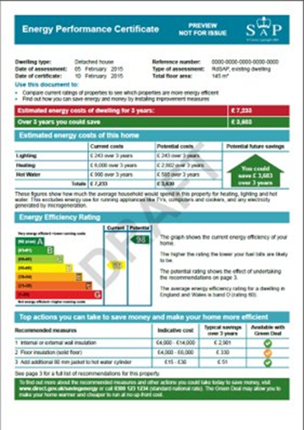

MEES requirements
From April 2020 – cannot let a property with an F/G rating if it legally requires an EPC
Trigger for a new EPC
      Sold
      Let on a new tenancy
      Converted into separate units
  There are exemptions.

Slide 4
Exemptions
Landlords or Agents register exemptions online with supporting documents. Exemptions are monitored by the Local Authority.
All relevant improvements made
High-cost exemption
Wall insulation exemption
Third party consent exemption
Property devaluation
Temporary exemption due to recently becoming a landlord

Slide 5
Enforcement and Penalties
Non-compliance
  From 1st April 2018, let a property in breach of the regulations
  From 1st April 2020, continue to let a property in breach of the regulations
  Registered false or misleading information on the Exemptions Register.

Slide 6
Enforcement and Penalties
Advice Letters
Compliance Notice – up to 12 months after the breach
  EPC valid at the time the property was let
  Any other EPC the landlord possesses
  Current tenancy agreement for the property
  Any report on the property
  Any other document for compliance and enforcement functions
Failing to comply with the compliance notice = fine of up to £2000 and may impose a publication penalty, to register the non-compliance on the EPC register, publicly accessible.

Slide 7
Enforcement and Penalties
Infringement | Penalty (Less than 3 months in breach) | Penalty (3 months or more in breach)
Renting out a non-compliant property | Up to £2000 and/or publication penalty | Up to £4000 and/or publication penalty
Providing false or misleading information on the PRS exemptions register | Up to £1000 and/or publication penalty | Up to £1000 and/or publication penalty
Failing to comply with a Compliance Notice | Up to £2000 and/or publication penalty | Up to £2000 and/or publication penalty
Total amount of the penalty is a maximum of £5000 per breach, per property

Slide 8
Government guidance for landlords: here and here
Check an EPC rating: here
Apply for a new EPC: here
Exemption register: here
Coventry Council MEES web page: here
Enforcement policy details: here
Report a concern to the Council: here
Useful links:

