Slide 1


Local Plan Review
Proposed Submission Regulation 19 consultation
coventry.gov.uk

Slide 2
Introduction – what is a Local Plan
The Local Plan sets out the level of growth needed over at least a 15 year plan period
It determines what type of growth is needed and where it should go
Local Plans also contain policies which inform the consideration of planning applications – these are on a range of matters including the environment, climate change, design and so on.
Local Plans have to be prepared in line with strict legislation and have to be examined by an independent Planning Inspector.

Slide 3
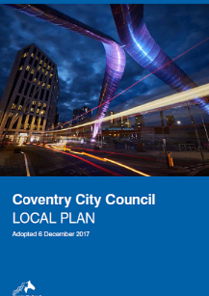
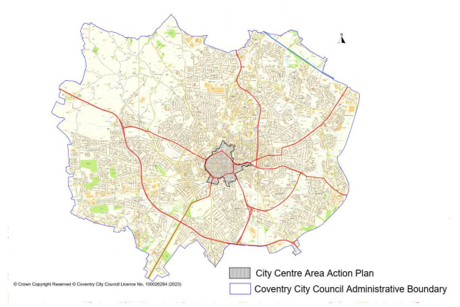
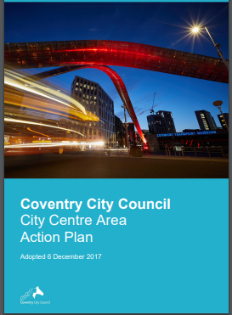
The adopted Local Plan & City Centre Area Action Plan

Slide 4
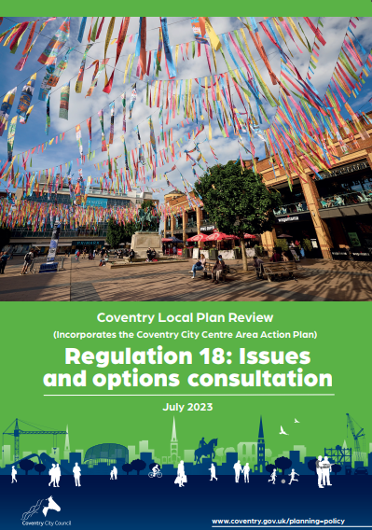
The Local Plan Review Process
First stage of the review was consulted on in summer 2023.
Over 1700 comments received
We have taken these into account in the update of the Local Plan
We have also produced updated evidence to inform policy review

Slide 5
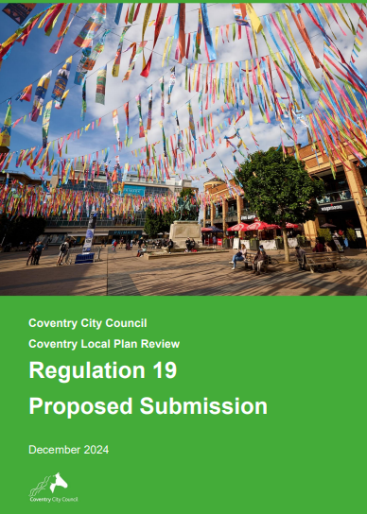
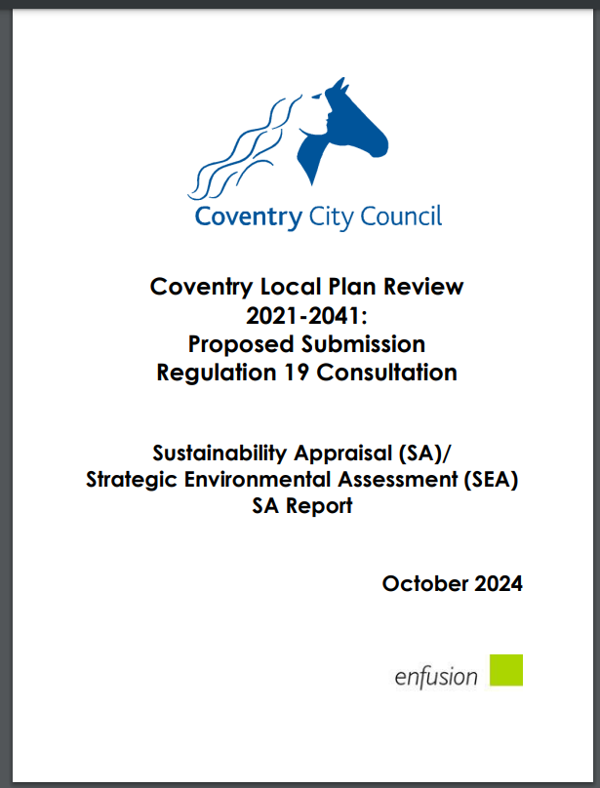
Headline issues
Reviewing the Local Plan and Area Action Plan together – aim to merge into a single document
Plan for a minimum of 29,100 homes by 2041
Plan for a minimum of 60 hectares employment land to 2041
Plan development has been informed by Sustainability Appraisal

Slide 6
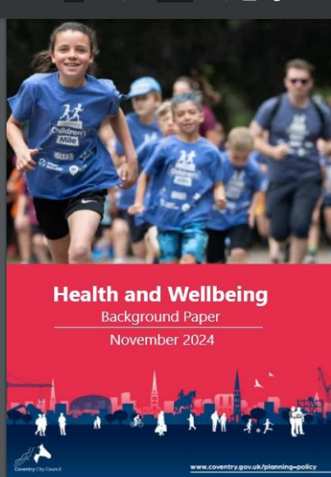
Health policies
Currently, Health Impact Assessment is undertaken for large schemes (150 dwellings and over)
Further detail is provided in a Supplementary Planning Document (SPD)
The SPD will be updated, and as part of this we will expect developments of 10 dwellings or more to show how they have taken health matters into account when designing schemes

Slide 7

Employment policies
Updated evidence to make sure we protect our most important employment sites
The employment market is constantly changing (especially offices and changed working patterns) so we are proposing more flexible policies to help us adapt
We have a supply of 60 hectares employment land for local need but need to find another 45 hectares. We also need to address strategic employment (‘big box’) need. We are discussing this with our partners across Warwickshire

Slide 8
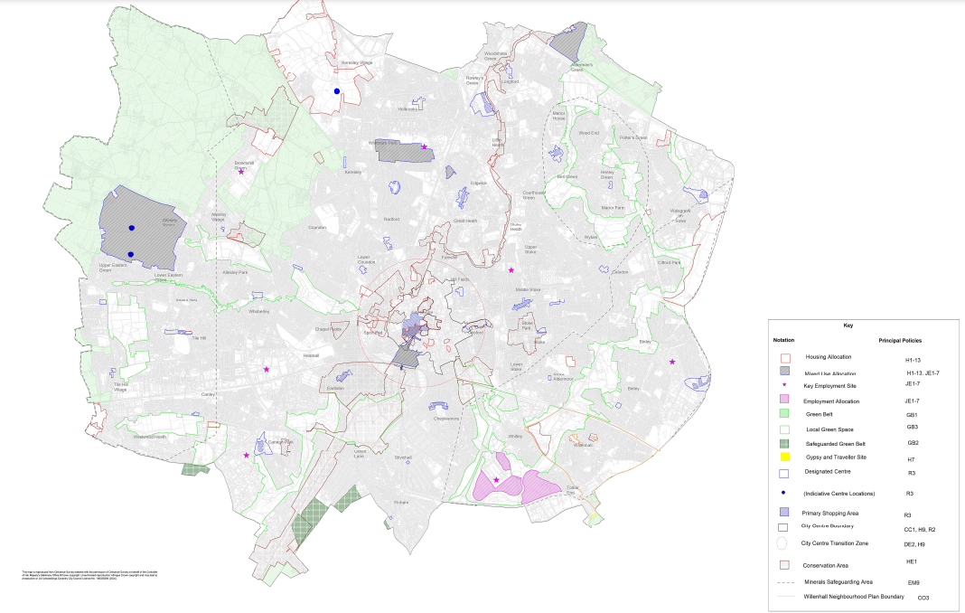
Housing allocations
12 new allocations
  With a Brownfield and urban area focus
2no modified existing allocations
  Updated to reflect market conditions and promoting best use of development land
  Detailed breakdown included at appendix 9(b) of consultation

Slide 9
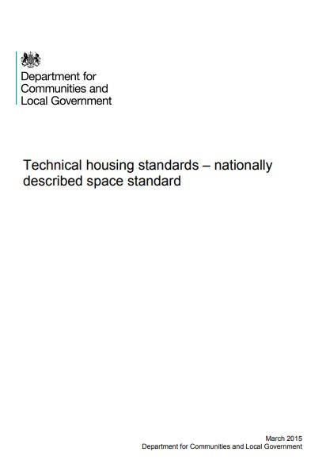
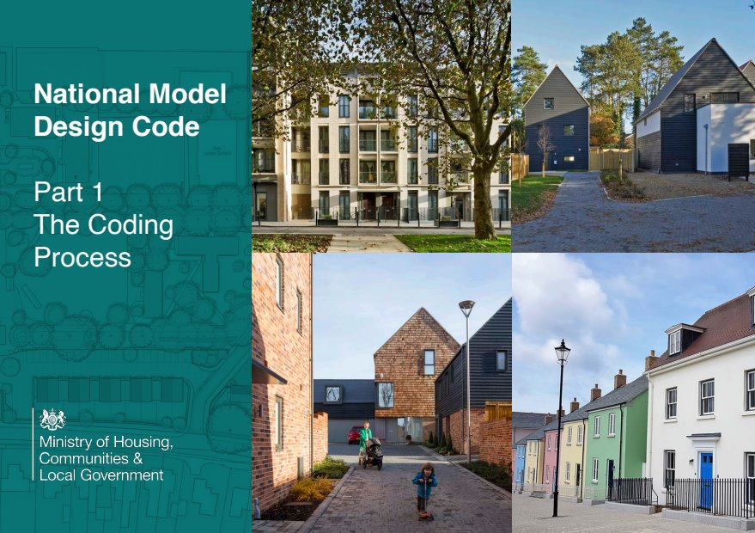
Housing standards
Adopt National Space Standards
Produce Design Codes
Adopt Natural England standards to increase access to open space
Restrict student accommodation to campus areas unless need justified
Affordable Housing – 25% (schemes of 10+ dwellings) & more social rented
Updated policy for other types of dwelling eg Gypsy & Traveller pitches, co-living,older persons / specialist accommodation

Slide 10
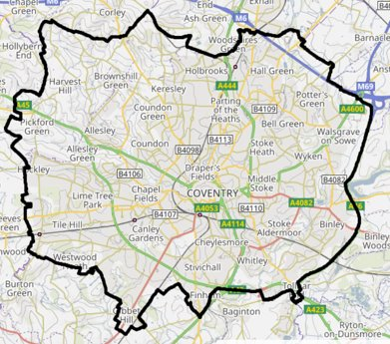
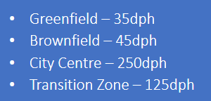
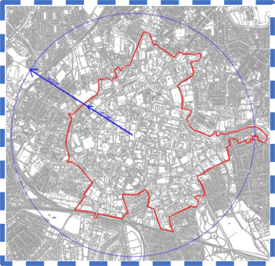
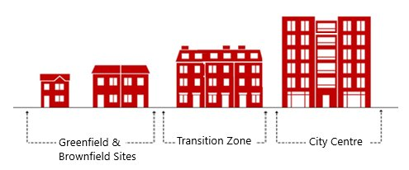
Development density
Informed by existing context and consented precedents
Must be compatible with local context

Slide 11
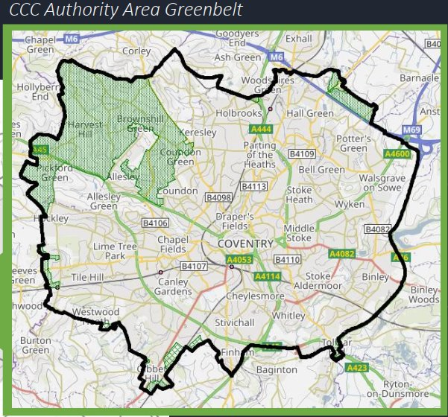
Green Belt & Green Infrastructure
No proposed changes to Green Belt boundaries
Protect Green Belt boundaries and designations
This includes designations of safeguarded Green Belt sites
Protect Local Green Space – proposed to have its own policy
Updating GI policies in light of changed legislation – Environment Act. Include Blue Infrastructure

Slide 12

Climate Change & Environment
Going over and above national Building Regulations standards for residential and non-residential new build developments
New standards proposed for
  On site renewable energy generation
  Restricting the use of fossil fuels
  Improving thermal efficiency

Slide 13
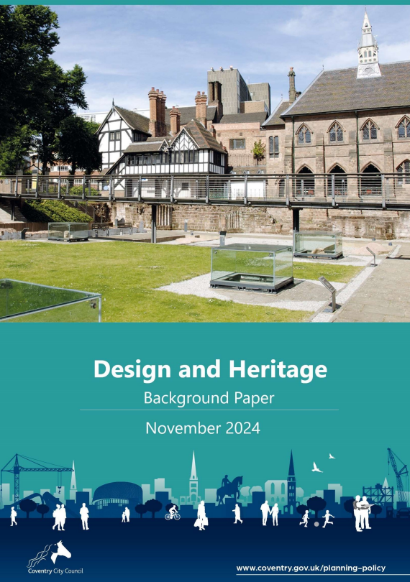
Design & Heritage policies
Expanded design policies, promoting national best practice, with a particular focus on creating healthy communities.
Updated conservation policy, referencing the City's key heritage assets
A new archaeology policy
Introduction of new internal space standards for residential development

Slide 14
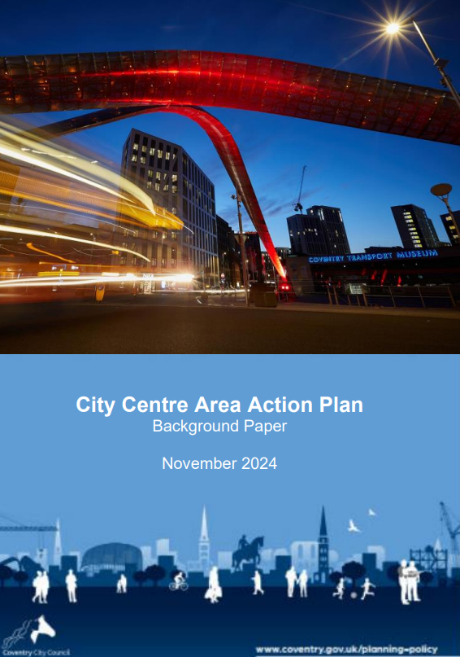
City Centre policy
Existing AAP proposed to be integrated into Local Plan.
Policies updated to reflect the evolution of the City Centre since 2017
Expansion of some City Centre policies to cover a wider area

Slide 15
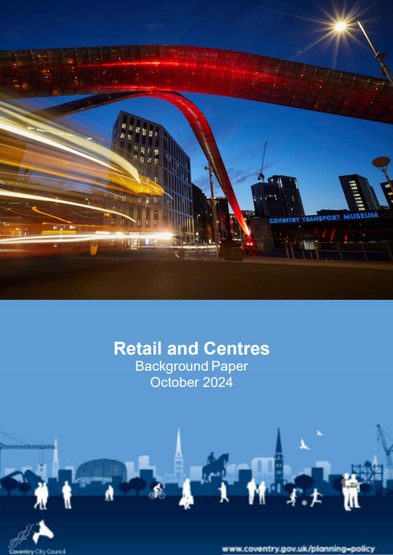

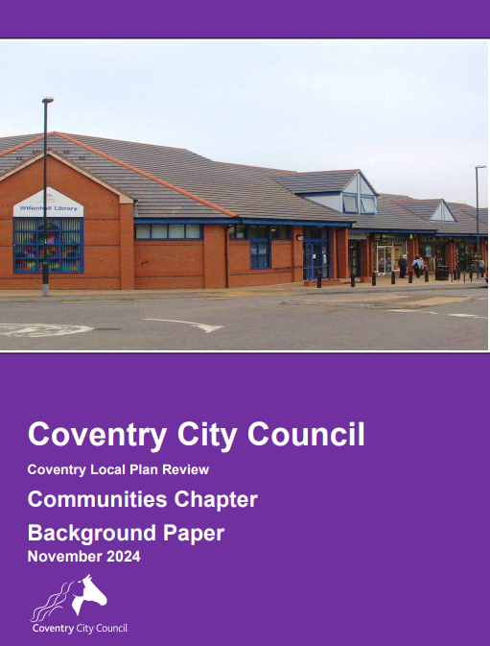
Other policy updates
Bringing retail and transport policies up to date in line with evidence, local and regional strategy and national changes to legislation.
Other policies (minerals, waste, communities) considered to require no / minimal updating

Slide 16
Next steps: responding
At the Regulation 19 stage you can comment on the following:
Legal compliance
Soundness. Is the plan:
  Positively prepared
  Justified
  Effective
  Consistent with national policy
Whether the Plan has met the statutory Duty to Co-operate
The Sustainability Appraisal can also be commented on

Slide 17
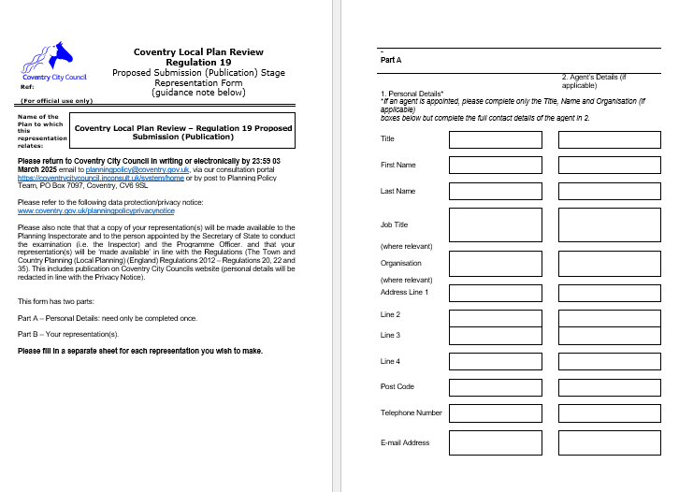
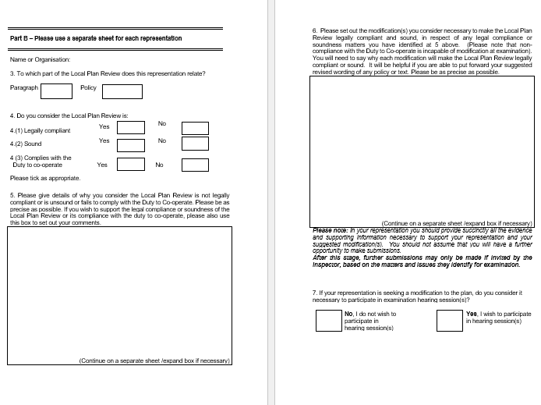
How to respond
The response form is on the website
Part A – your details
Part B – your comment (representation).
Guidance notes are also on the web page
Deadline for submission 11.59 on Monday 3rd March 2025 to planningpolicy@coventry.gov.uk

Slide 18
What happens next
All representations will be assessed
A report will be taken to Cabinet / Council to determine if the plan can be submitted to the Secretary of State
Once submitted the plan will be examined by a Planning Inspector to determine whether it is sound and can be adopted.
Timelines are contained in the Council’s Local Development Scheme (LDS)

Slide 19
Links and contacts
https://www.coventry.gov.uk/localplanreview
Planningpolicy@coventry.gov.uk
Thank you for listening
Any questions?

