Slide 1


Early Help is a partnership of organisations that provide help, advice and support to children, young people and families.
The aim of Early Help is to help as soon as possible by providing the right help at the right time by the right people.
Early Help services can help families, children and young people - pre-birth to 19 years old and 25 years old where there are special educational needs or disabilities.

Slide 2
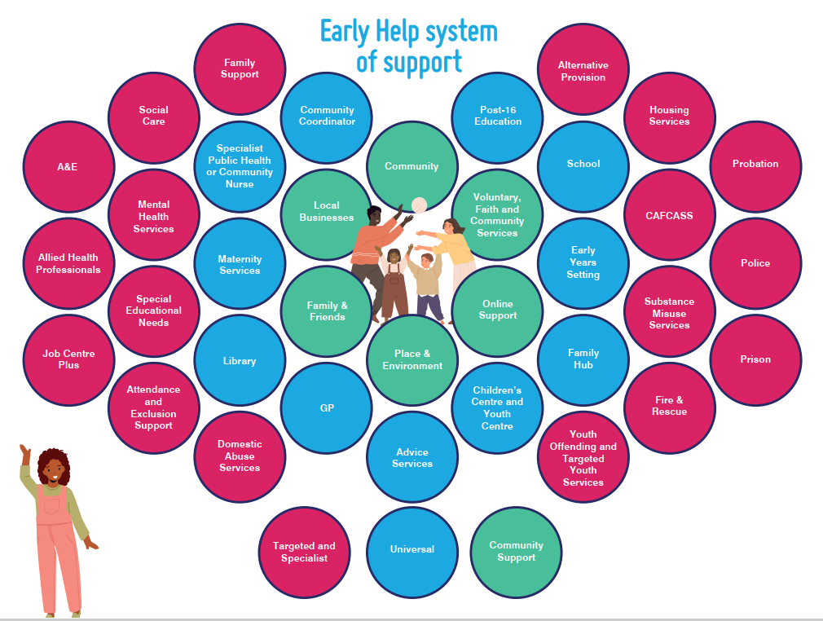
You can see from this honeycomb affect the early help system of support.
The Early Help System is not a single service. It is a network of services, processes and interactions that aim to help children, young people and families at the earliest opportunity.
A strong Early Help System is made up of many different types of practitioners and services who operate as one.
You will note that the schools are a vital part of the Early Help Strategy.

Slide 3

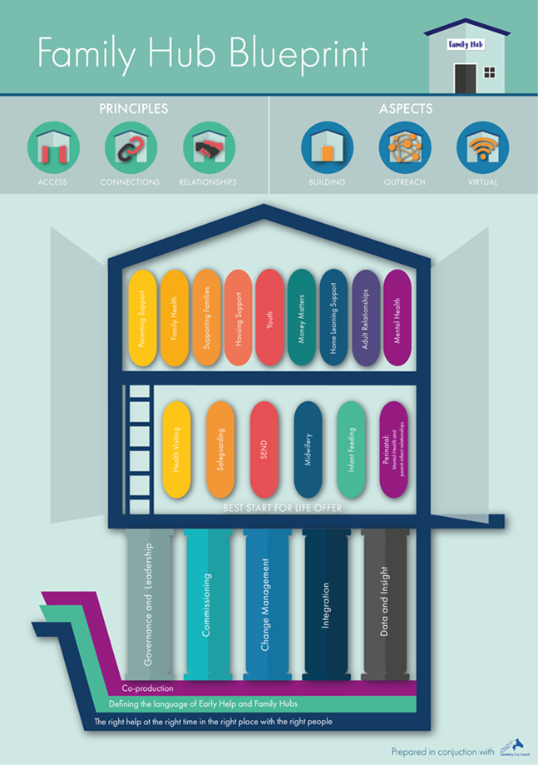
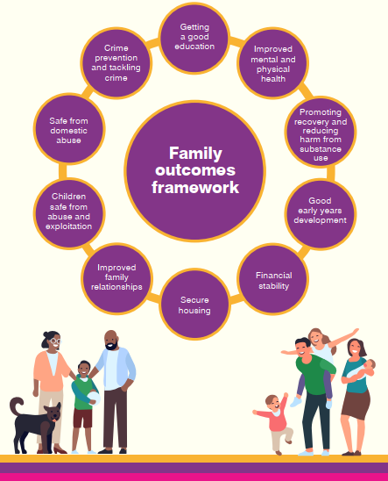
Two funded National Programmes delivered to provide local Early Help to families

Slide 4
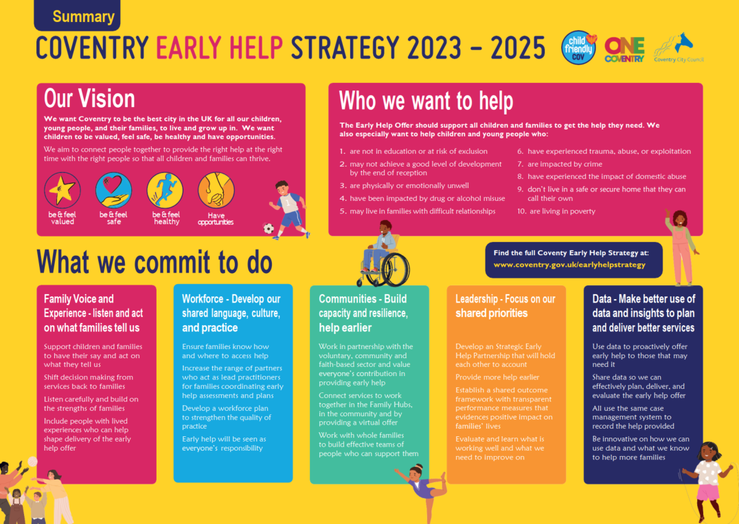
The Early Help Strategy describes how we can develop and deliver a whole system partnership offer. Coventry can collectively ensure children and their families receive the right help at the right time with the right people, to enable children to reach their full potential.
The Early Help Strategy focuses on the implementation of the national programmes that are the key drivers in the delivery of Early Help:
The Family Hub and Start for Life Programme and the Supporting Families Programme will be developed and implemented by the Early Help Partnership to enable the delivery of the Early Help Strategy.
https://www.coventry.gov.uk/earlyhelpstrategy

Slide 5
The Language of Early Help
Our purpose : “Enabling children and their families to get the right help at the right time with the right people”
The early help offer – “is the support given to a child, young person and their family when a problem first emerges. Help may be required at any stage in a child’s life from prebirth to adulthood and applies to any problem or need that the family cannot deal with or meet on their own.”
The early help system : “ the network of services, processes and interactions that aim to help children, young people and their families at the earliest opportunity”. It is made up of different types of practitioners and services working together to provide a coherent and co-ordinated offer.
Supporting Families : an approach to work with whole families who have multiple needs through co-ordinated intensive family support. This support is identified though an early help assessment and delivered early help plan, led by a Lead practitioner and enabled by the work of the team around the family, working with them to help bring about sustainable changes and improve the children’s lives.

Slide 6
The Language of Early Help
The Family Hub Offer : the universal front door to families, offering a “one stop shop” of family support services for all families. This is a partnership offer provided from across a wide range of sources of help that connect together to provide high quality joined up support. The offer includes services delivered from a Hub building, delivered in communities and through a virtual offer. It is based on three principles of Access, Connections and Relationships.
Start for Life Offer – the universal offer available to all families in the first 1001 days (0-2) bringing together 6 mandated services, which are core to the family hub offer.
  Midwifery
  Health Visiting
  Perinatal mental health support
  Infant Feeding
  Early years SEND
  Family help (safeguarding)

Slide 7
A video has been produced to highlight the early help system.
I am Early Help V4.mp4​

