Slide 1

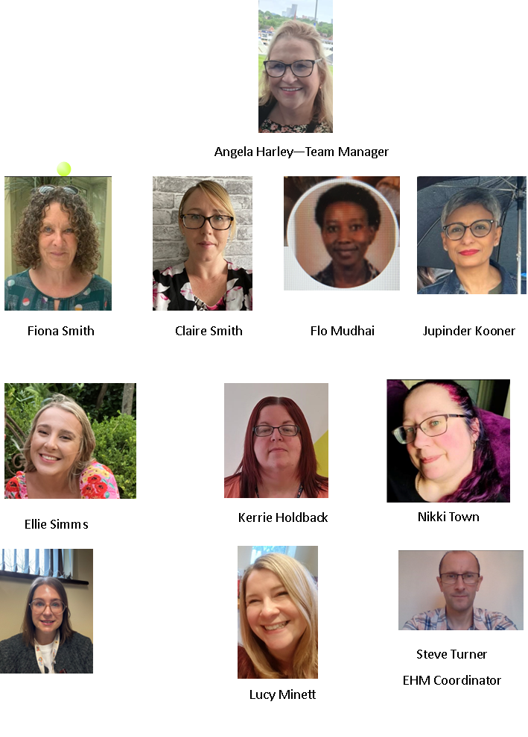

The Early Help
Assessment Coordinators
(EHACs)

Slide 2
The Role Of The EHACs
There are 9 EHACs and 1 EHM Coordinator in Coventry, the team are based within Coventry’s Childrens Services Early Help
They are responsible for the support, development and promotion of Coventry’s Early Help offer.
They work closely with all partner agencies to:
Offer Advice & Guidance
Practical support
Support with recording on the Early Help Module (EHM)

Slide 3
The Role Of The EHACs
They work with all partner agencies within Coventry’s Early Help offer, this includes:
All Primary and Secondary schools
Extended Learning Centre’s
Special Schools
Private schools
Private Nursery settings
Health Agencies including, GP Surgeries, Midwifery, Health Visitors & School Nurses
Change Grow Lives
Coventry Haven
Panahghar

Slide 4
Advice & Guidance
EHACs will visit their allocated schools every half term for a meeting to discuss any children & families that may require an offer of early help support.
They will meet with all their allocated agencies to discuss any children and families that may need some level of additional support.
EHACs have an extensive knowledge of many different agencies in Coventry and can signpost to these agencies if a family is in need.

Slide 5
Practical Support
Practical support can come in many ways, for example:
An EHAC can accompany you on home visits where there is an assessment/plan, or you are in the process of completing one.
An EHAC will meet with parents / carers to discuss early help support that is available.
They can attend team meetings to share good practice.
The EHAC team deliver workshops.
They can start assessments and plans for children & families on behalf professionals.
Your EHAC can support you in Team Around the Family Meetings.

Slide 6
Support With Recording on EHM
Practical support can come in many ways, for example:
Your EHAC will provide oversight on your assessments and plans.
They can support you to record information on EHM and provide ongoing user support.

Slide 7
To contact an EHAC please use the phone number or email address below:
Telephone: 0800 8870545
Email: earlyhelp@coventry.gov.uk

