Slide 1

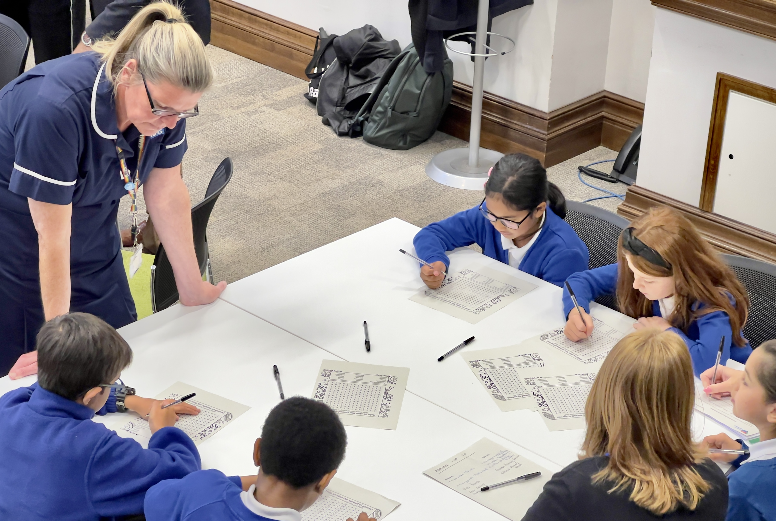
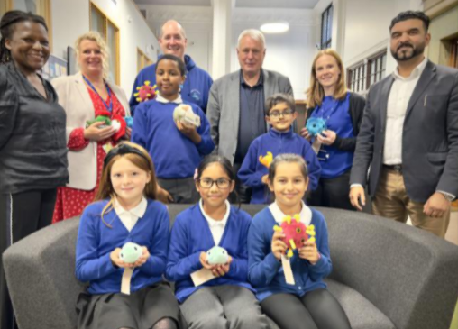

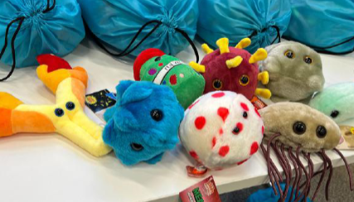
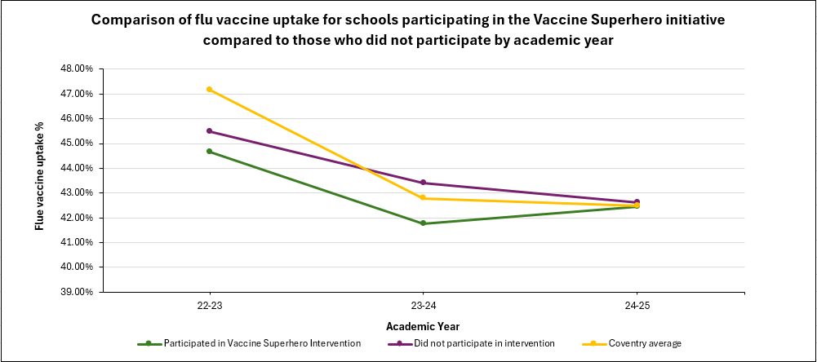
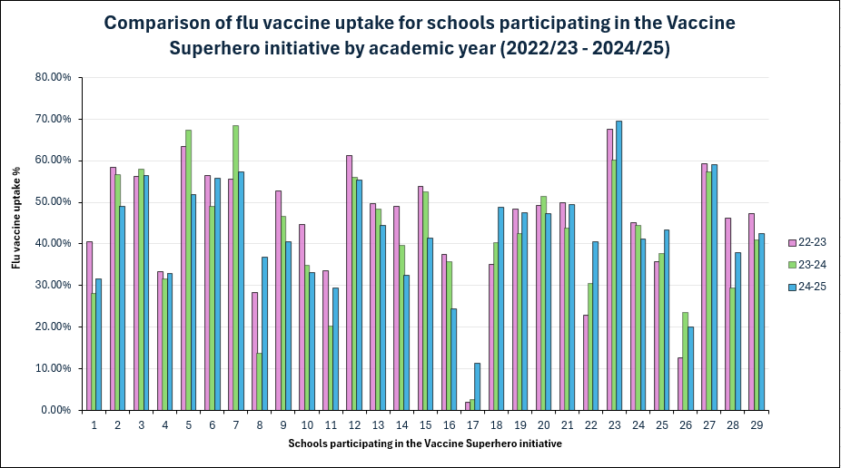
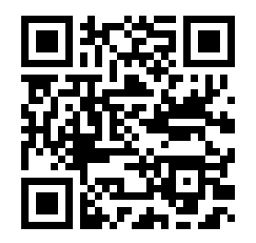
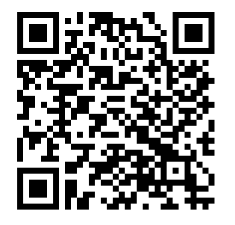
Vaccine Superhero Programme – A school-based health Initiative for Primary and SEND schools
Rayyan Nasser (Health Protection Programme Officer), Coventry City Council
Lily Makurah (Consultant in Public Health), Coventry City Council
Coventry City Council Public Health
INTRODUCTION
METHODS
Childhood vaccination rates in Coventry has declined since 2016/17, with many vaccines continuing to fall below the recommended 95% vaccine coverage needed for herd immunity to protect those who can’t get vaccinated. Local responses to both the COVID-19 pandemic, and more recently measles cases, demonstrate the importance of working together with partners to deliver effective vaccine interventions.
Coventry City Council Public Health and the School Aged Immunisation Service (SAIS) launched the ‘Coventry Vaccine Superhero’ Programme in 2024, a three-tiered school initiative that relies on strong partnerships. This initiative was launched during the height of the measles response when collaboration between partners and schools was also at its peak. Additional communication efforts were shared with schools located in low uptake areas to encourage sign up due to their increased vulnerability to infectious disease outbreaks.
The purpose of this initiative is to improve attitudes towards vaccination through fun educational activities that will contribute towards improvements in school aged vaccination rates. By encouraging children, parents, and teachers to become vaccine champions, the programme creates a supportive school environment that promotes vaccination as a lifelong health priority.
Participating schools are provided with resources including e-Bug lesson plans and worksheets as well as Giant Microbe plush toys funded by Coventry City Council Public Health to make learning interactive and engaging.
A quantitative data analysis on flu vaccine uptake was carried out :
to understand trends across England and the Midlands compared to Coventry.
to review whether this initiative has had any impact on the latest flu vaccine programme (Autumn 2024) in participating schools compared to non-participating schools.
Data was sourced from the following:
Annual average percentage uptake was calculated using COVER data at national, regional, and local levels (UK Health Security Agency, 2025). This data was validated by the Coventry and Warwickshire ICB Immunisation team.
School level uptake data was obtained from SAIS (annual average percentage uptake). Data analysis was carried out on 29 of the 31 participating schools with complete pre- and post intervention data. Mean uptake per school was calculated for comparison.
Figure 1. The e-Bug and Giant Microbe resource pack provides the foundation for schools working towards a Vaccine Superhero award.
Figure 2. Images taken from the launch event attended by school representatives, Council Leader, Councillor, SAIS nurses and pupils and staff members from Holbrooks Primary School.
RESULTS
Annual COVER data shows that uptake for flu vaccination in primary school-aged children has recently declined in England, the Midlands, and Coventry (Figure 3).
Flu vaccine uptake in Coventry schools was higher than regional and national averages in previous years but declined after the COVID-19 pandemic. Coventry uptake remains below the national and regional levels since 2020/21.
Period | England % uptake | Midlands % uptake | Coventry % uptake
2018/19 | 60.49% | 61.88% | 68.08%
2019/20 | 60.40% | 60.55% | 65.91%
2020/21 | 62.50% | 60.47% | 54.50%
2021/22 | 57.40% | 55.60% | 47.07%
2022/23 | 55.89% | 53.41% | 47.17%
2023/24 | 55.11% | 52.06% | 42.78%
2024/25 | 54.60% | 50.99% | 42.48%
Figure 4. Graph showing a gradual decrease in uptake in non-participating schools, while participating schools showed a 0.68% increase this flu season compared to the previous year.
Figure 3. Table showing the decline in flu vaccine uptake in primary school-aged children in England, the Midlands and Coventry between 2019-2024. Data sourced from COVER (UK Health Security Agency, 2025).
However, in participating schools, flu vaccine uptake increased in 2024-25 compared to the previous year, while non-participating schools continued to see a decline in the same period (Figure 4).
Flu vaccine uptake in participating schools are now in line with the Coventry and non-participating school averages (Figure 4).
While vaccine uptake varied across participating schools, School 17 with the lowest figures in 2022/23 saw the highest increase in vaccine uptake (+8.6%) in the latest 2024/25 flu vaccination programme (Figure 5).
Figure 5. Bar chart showing the differences in flu vaccine uptake in participating schools in the last three years.
DISCUSSION
CONCLUSIONS
REFERENCES
The increase in flu vaccine uptake observed in participating schools indicates the programmes effectiveness in highlighting the importance of vaccination and improving uptake.
Future analysis should be carried out to assess the impact of specific elements of the initiative (e.g. e-Bug, Giant Microbe resources, awards) to determine whether certain elements contributed to the increased uptake. This could streamline the costs and coordination efforts by identifying resources that may not be effective in driving uptake.
Due to limited data, the analysis for each school was based on calculating mean percentages for comparison. However, analysing the actual number of vaccines administered would have been a more robust approach, offering greater accuracy and insight. Direct comparisons cannot be drawn between participating and non-participating schools, but we can describe potential trends within each group.
This initiative has demonstrated it can be adopted by primary and SEND schools to enhance vaccine education and improve uptake. However, further analysis is needed to draw firm conclusion on its overall effectiveness.
Partnership working strategies are key to delivering effective vaccine interventions.
The increase in vaccine uptake observed in school 17, typically a low uptake school, highlights the potential for this initiative to tackle specific challenges unique to each setting.
UK Health Security Agency (2025). Vaccine uptake guidance and the latest coverage data. [online] Available at: https://www.gov.uk/government/collections/vaccine-uptake
For more information on the programme:
ACKNOWLEDGEMENTS
SCAN HERE
SCAN HERE
This delivery and evaluation of this project would not be possible without the support and collaboration of the following teams:
Coventry City Council Health Protection Team, Coventry School Aged Immunisations Service (SAIS), Coventry Primary and SEND schools, Coventry City Council Education, Coventry ICB and Coventry NIHR Health Determinants Research Collaboration (HDRC).
to read our newsletter
to visit our website

